Slide 1
Ionic Equations

Slide 2

Silver nitrate & sodium chloride

Slide 3
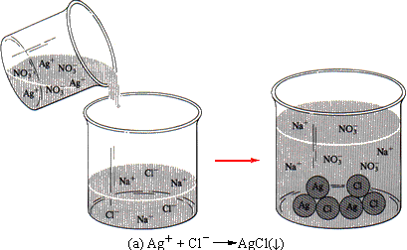

Slide 4

Hydrochloric acid & sodium hydroxide

Slide 5
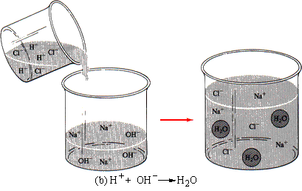

Slide 6
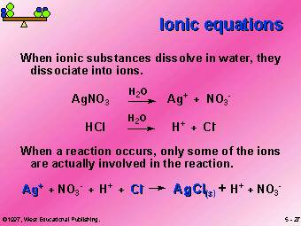

Slide 7
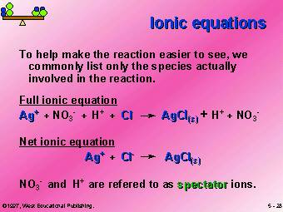

Slide 8
RULES FOR WRITING IONIC EQUATIONS
1 Strong electrolytes are written in ionic form
2 Weak electrolytes are written in molecular form.
3 Non-electrolytes are written in molecular form.
4 Insoluble substances are written as their formula.
5 Gases are written in molecular form.
6 Ionic equations should not include spectator ions.
7 Equ’s must be balanced in atoms and electrical charge.

Slide 9
RULES FOR WRITING IONIC EQUATIONS
A simple interpretation of these rules is “If it is not all ions floating around in solution before & still all ions floating around in solution after – its not a spectator”. So don’t remove it. Show it in full.

